Slide 1

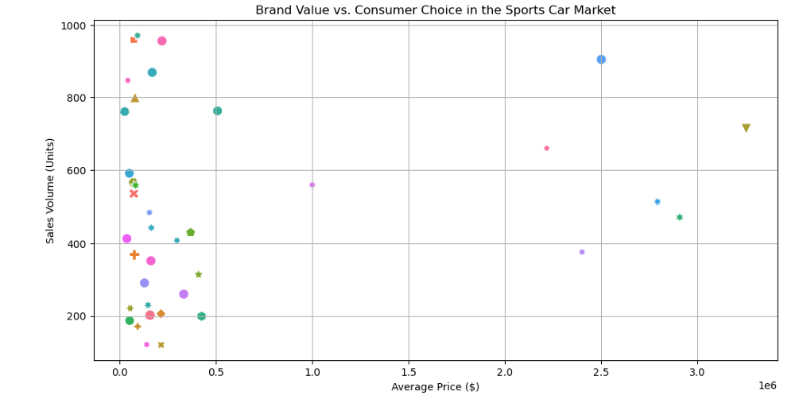
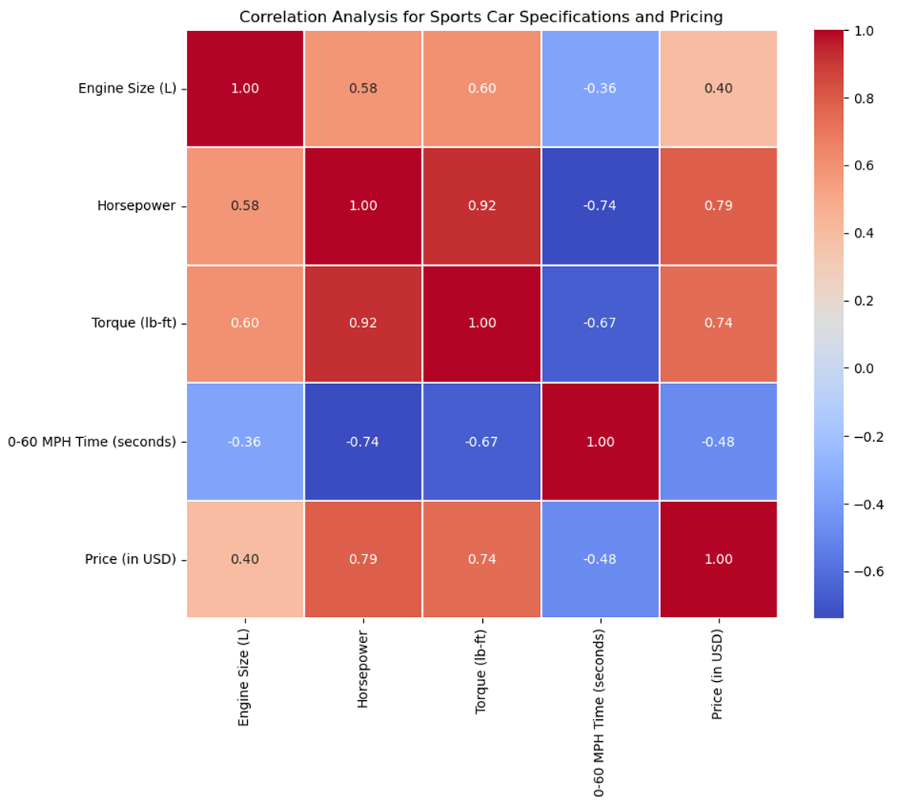
Brand Value Comparison
BIA 686
Business Intelligence & Analytics
Introduction:
Our dataset systematically combines data on 1007 distinct sports vehicle models from premier manufacturers such as Porsche, Lamborghini, Ferrari, Audi, and McLaren, including key attributes such as make and model, year, engine size, horsepower, torque, acceleration (0-60 MPH), and price in USD. These extensive entries create a solid foundation for examining market trends and performance indicators in the high-end sports vehicle business. This data is used to evaluate each model's engineering excellence as well as its market placement, providing insights into their industry standing and consumer perception.
Results:
Business Problem:
The experiment in this research used exploratory data analysis techniques on a dataset of 1007 sports automobiles to evaluate pricing strategies and performance indicators. The technique includes data loading and cleaning, feature conversion for quantitative analysis, heatmap correlation analysis, and presentation of car price-performance connections. This extensive investigation intended to find insights into premium pricing determinants and consumer preferences in the sports vehicle industry, allowing for more focused recommendations and improvements in future automotive development.
Research Questions:
How do average prices vary among different sports car brands, and which brands are positioned as premium versus budget-friendly?
What factors contribute to the premium pricing of certain sports car brands over others?
How does the brand value reflect in pricing influence consumer choice in the sports car market?
Conclusion:
Data visualization and statistical analysis are used to understand sports vehicle industry dynamics, identifying major price patterns and consumer preferences that will lead future developments and marketing initiatives.

